Slide 1
FINANCE AND RISK ANALYTICS
CAPSTONE PROJECT
- PRABHAT SHARMA

Slide 2
BUSINESS OBJECTIVE
To come up with key insights from the stock market analysis and accordingly design the portfolio for Mr Patrick and Mr Peter
Understanding the Investors’ profile to recommend them suitable investment strategy.
To fulfil the investors’ aspirations: Double the amount in next 5 years for Mr Patrick (Low Risk, High Returns) and recommend the maximum return giving stocks for Mr Peter (Ready to take risk, High Returns)

Slide 3
DATA PREPARATION AND ANALYSIS
All the 25 data files and Market Index (S&P 500) datasets was imported and was converted into single dataset with 5 years window.
The dataset has been grouped industry-wise, by Close price and by Volume.
The dataset did not included any missing values. Important Stock Visualizations were performed to gain insights with and without normalization using Plotly and Tableau both.
Important Metrics and Ratios were calculated for building a comprehensive portfolio for the investor
Expected returns were calculated for each stock for both the investors
Expected returns were then matched with investors aspirations to build the final portfolio

Slide 4
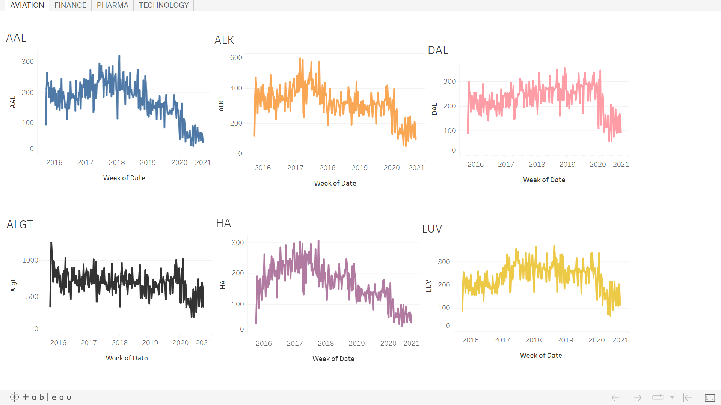
AVIATION
Based on the trend of these stock prices, it can be said that AVIATION sector in general has been hit very hard by the COVID PANDEMIC. Almost all stock prices shows NEGATIVE or SIDEWAYS trend from 2019-end onwards. One should avoid investing in the Aviation Sector

Slide 5
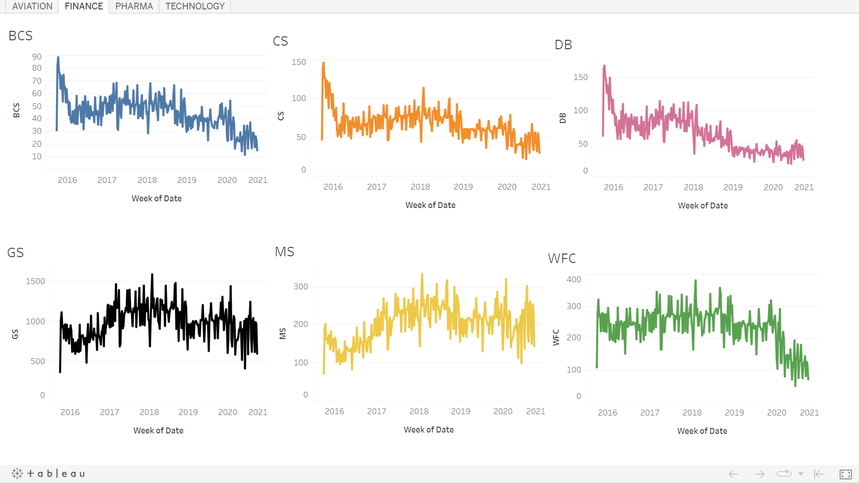
FINANCE
BCS, CS and DB has shown NEGATIVE trend over the years. Thus, its not recommended to invest in these stocks. GS and MS though started off well has not been able to consistently show positive trend. One should be careful in investing in these stocks. WFC though has shown consistent performance, it has not been able to register a sustainable positive growth.

Slide 6
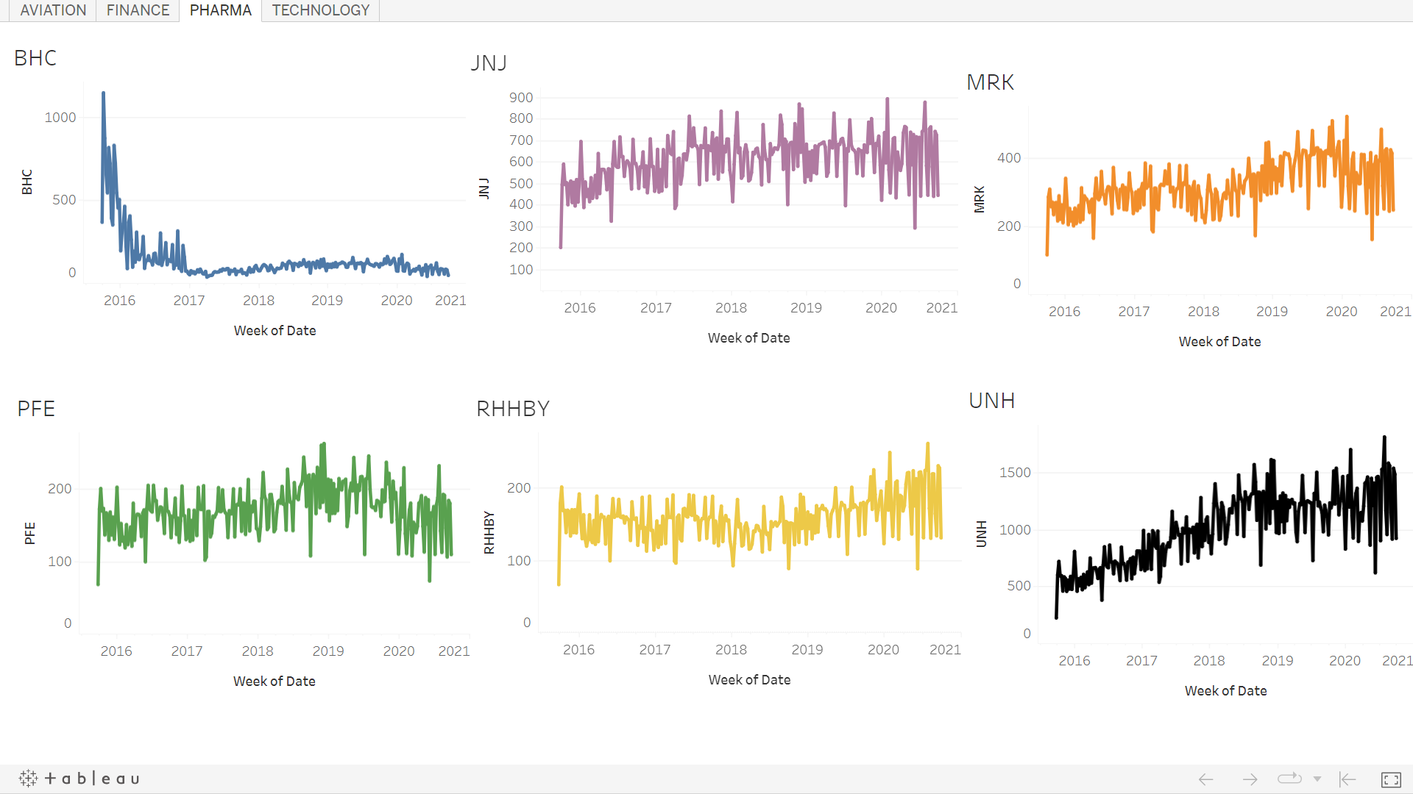
PHARMACY
The overall value of BHC has remain very low, also JNJ, MRK, PFE and RHHBY has more or less shown SIDEWAYS trends. UNH has shown a good POSITIVE trend, and hence could be a good option of investment. It looks like PHARMA industry has been able to withstand COVID shock.

Slide 7
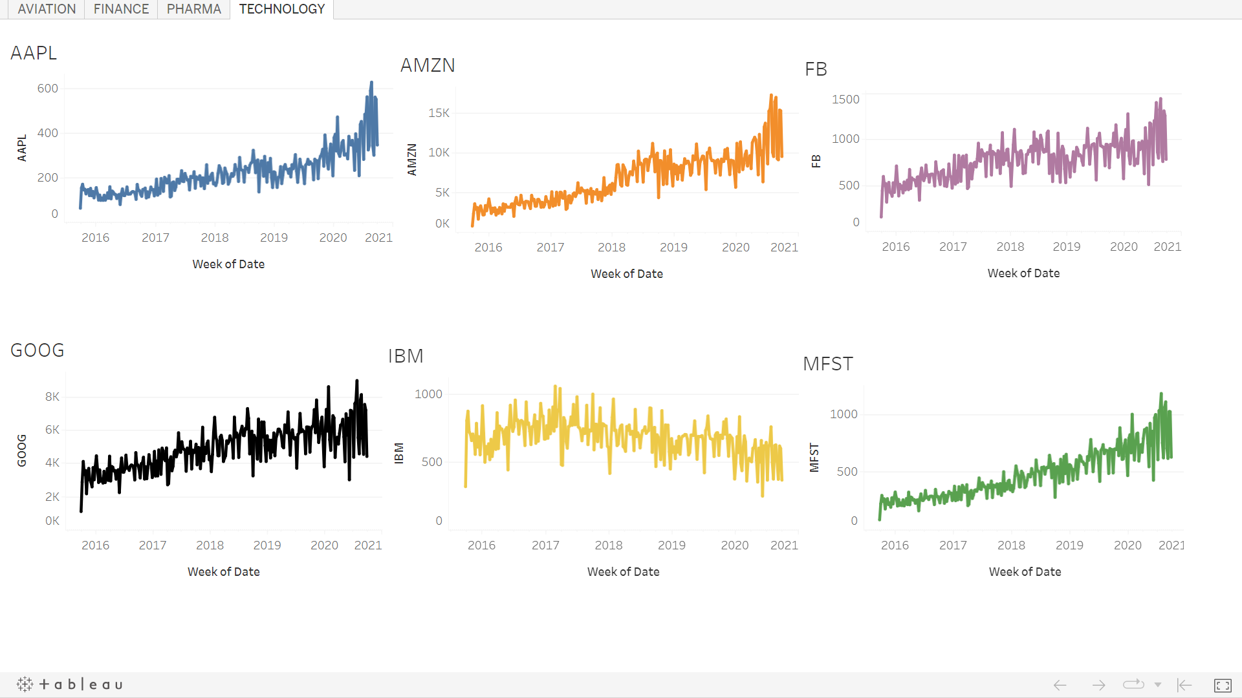
TECHNOLOGY
The TECHNOLOGY industry seems to be gaining with the COVID onset. Except IBM all other big tech. companies has shown POSITIVE TREND. In fact, the upward trend became steeper during and post-COVID period. AMZN, AAPL, and MFST has shown tremendous upward trend. This industry is highly INVESTMENT FRIENDLY

Slide 8
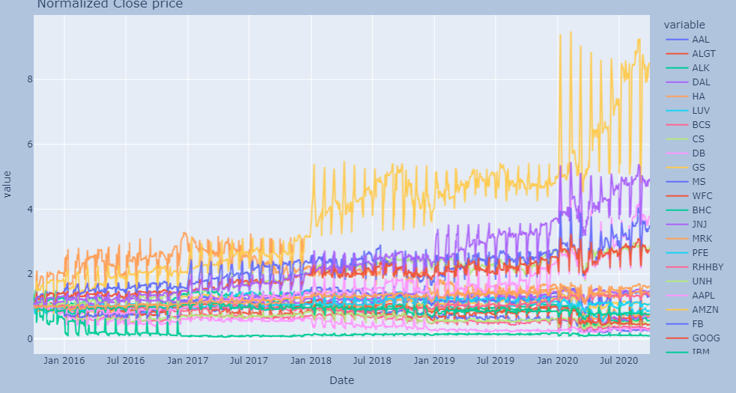
NORMALIZED PRICES
After NORMALIZATION, it has been observed that the TECHNOLOGY industry has out-performed other industries. AMZN, MFST, AAPL and FB has registered positive trend in the last 5 years

Slide 9
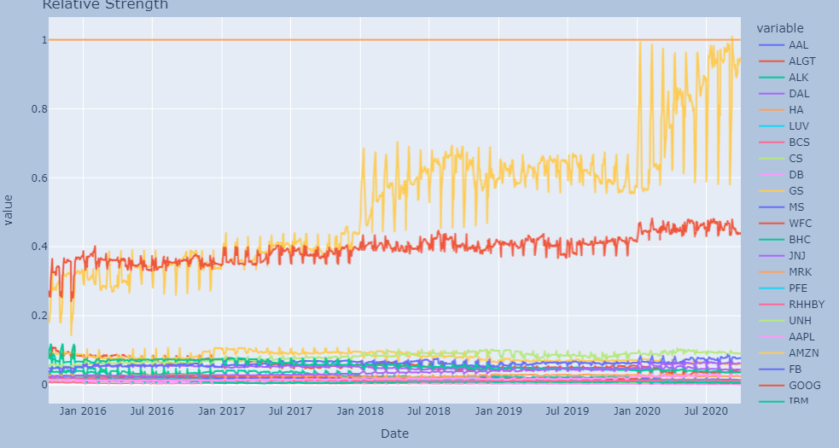
RELATIVE STRENGTH
AMAZON and GOOGLE performed better than the industry standards. Rest all seems to be low in terms of value with respect to the benchmark (S&P 500)

Slide 10
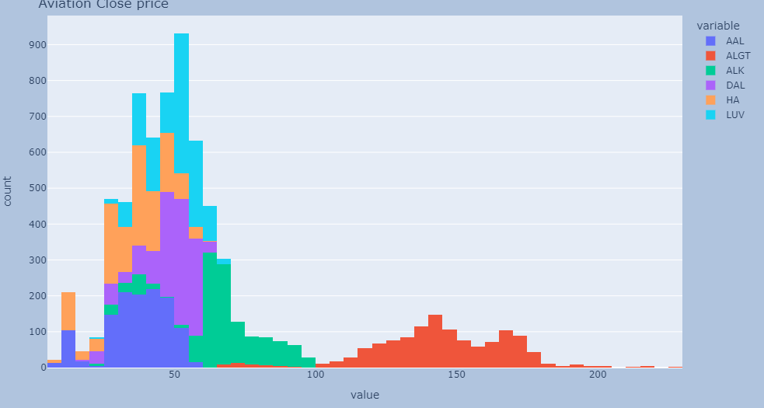
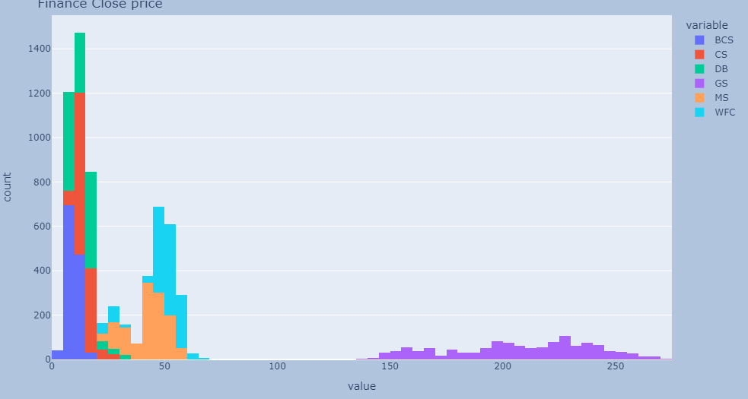
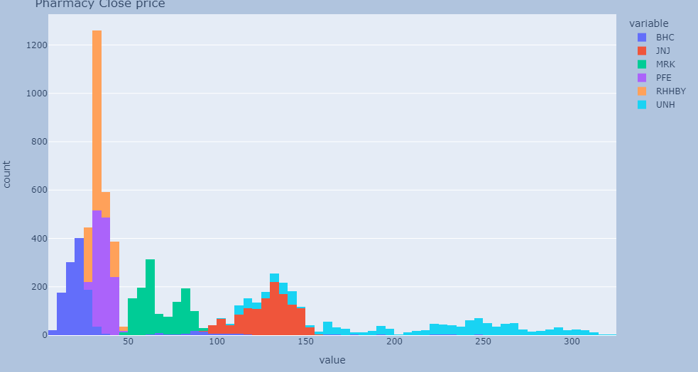
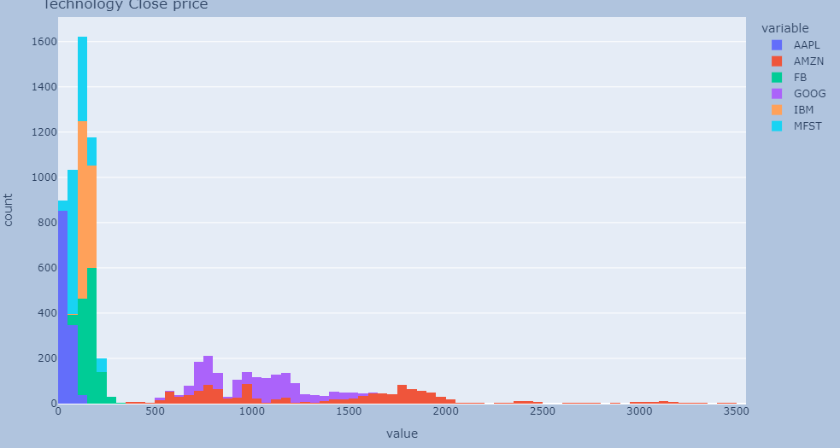
AVIATION
FINANCE
PHARMACY
TECHNOLOGY

Slide 11
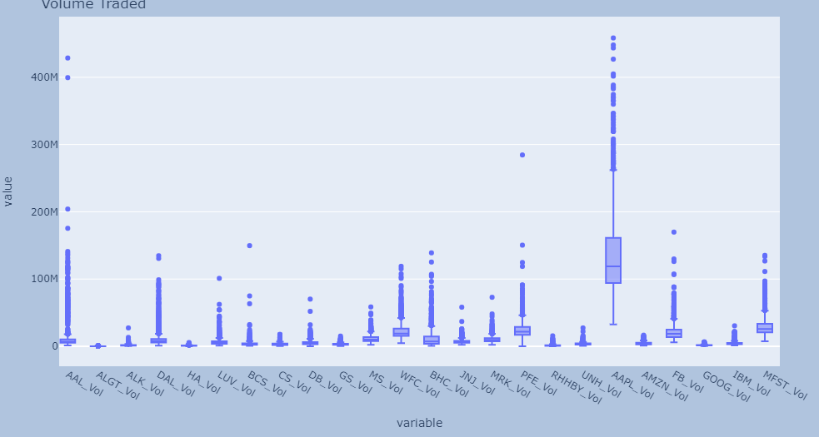
VOLUME TRADED

Slide 12
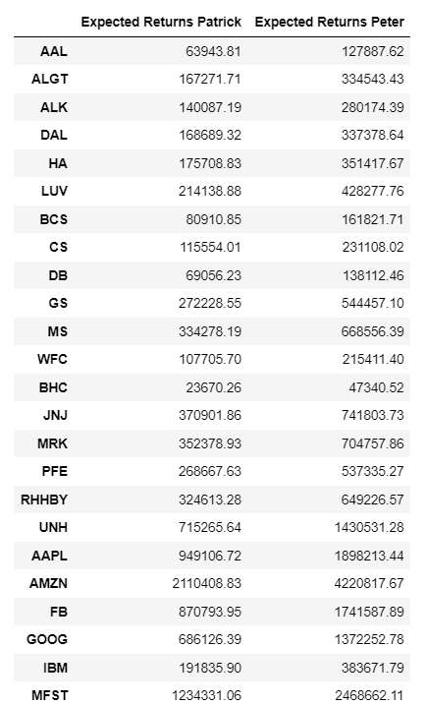
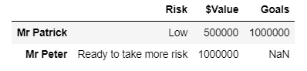
PORTFOLIO
INVESTOR’S PROFILE
The table on top shows the Investor’s profile and what they tends to achieve by investing in the stock market
The table on the right shows returns Mr Patrick and Mr Peter gets for investing in each stocks

Slide 13
CONCLUSIONS
AVIATION industry is not lucrative for investment
FINANCE & PHARMACY though has been able to withstand and sustain throughout 5 years window, may still not able to give investors the expected returns.
TECHNOLOGY industry has a promising outlook. It is highly recommended to invest in this industry having stocks with a good track history.

Slide 14
RECOMMENDATIONS
Based on the risk an investor is willing to take, following things can be recommended:
For Mr. Patrick : Either of AMZN or MFST gives him the desired returns
For Mt. Peter : Any of these 3 stocks can give him the highest returns (with different risks associated for each) – AMZN, MFST or AAPL

Slide 15
APPENDIX : Making sense of key terms
Normalized prices : Increase in the stock prices compared to Day 1 of the window
- If greater than 1 : positive trend
- If less than 1 : negative trend
2. Relative strength (w.r.t SP 500)
- positive slope means : It is performing better than the industry
- negative slope means : worse than industry
- sideways movement : At par with the industry
3. Sharpe Ratio
- Higher the sharpe ratio, more attractive is the stock
4. Annualized Returns : It is the geometric average amount of money earned by an investment each year over a given time period

